Slide 1

Power Analyzer
Nathan Zimmerly (EE) & Ryan Rabello (CpE)

Slide 2
What is the Power Analyzer?
A device and service that aims to lower power consumption through intuitive data visualization.
Notes:
Moving off campus and seeing power bill.

Slide 3
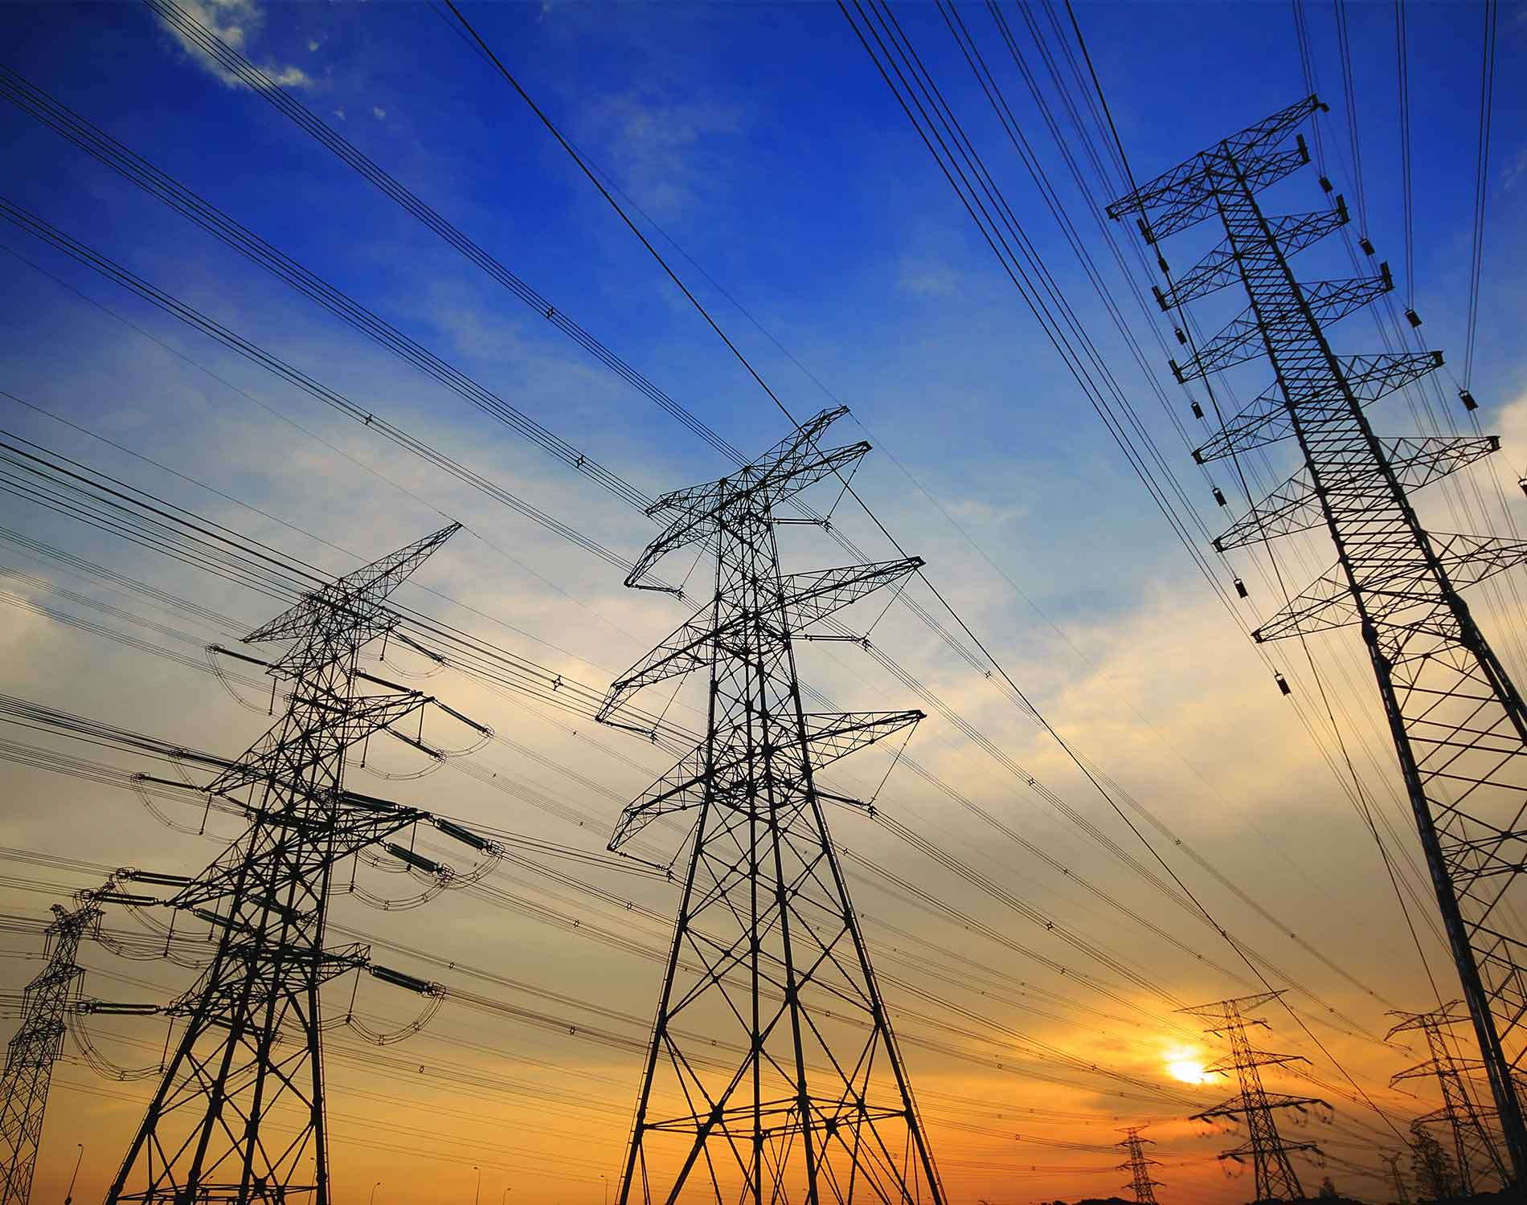
Why this is important?
Environmental factors
Power usage and costs are increasing.

Slide 4

Example Successes
The application of the proposed tools led to economic savings of around 15%
More than 30% energy saving was achieved immediately after installing a monitoring system in a residential household…

Slide 5
Project Overview
Requirements
Build a device for data collection
Store data from the device in server
Display information online
Event Notifications
Ideal goals
Authentication
Electric bill prediction
In-depth data analysis
Peak consumption time.
Consumption classification using machine learning.
Export data feature
Notes:
Requirements
Build an embedded device for data collection
Store data from embedded device
Display information online
Event Notifications
Ideal goals
Authentication & User management
Electric bill prediction
In-depth data analysis which would calculate what time of day on average you consume the most energy.
Export data feature
Low cost (optimize cost)

Slide 6
Benefits
Target specific areas to upgrade for more devices. (LED lighting)
Increase faculty and student awareness.
Power usage emails sent to departments.
Email notifications for abnormal readings.
Find circuits that use the most power.
Compare similar circuits with each other.

Slide 7
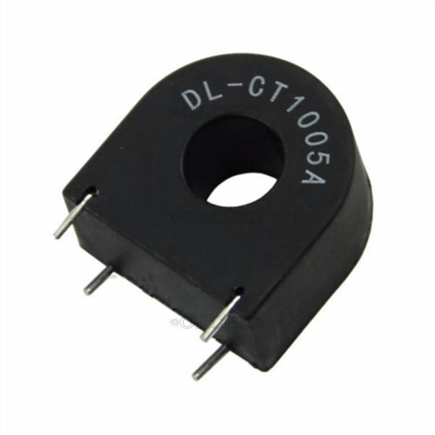
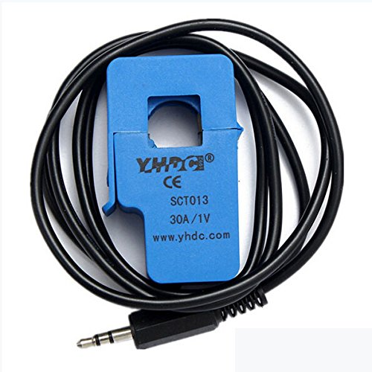
Installation
Pros:
Cost: $1
Cons:
Harder installation
Soldering wires
Pros:
Easy installation
Simple maintenance
Cons:
Cost: $5

Slide 8
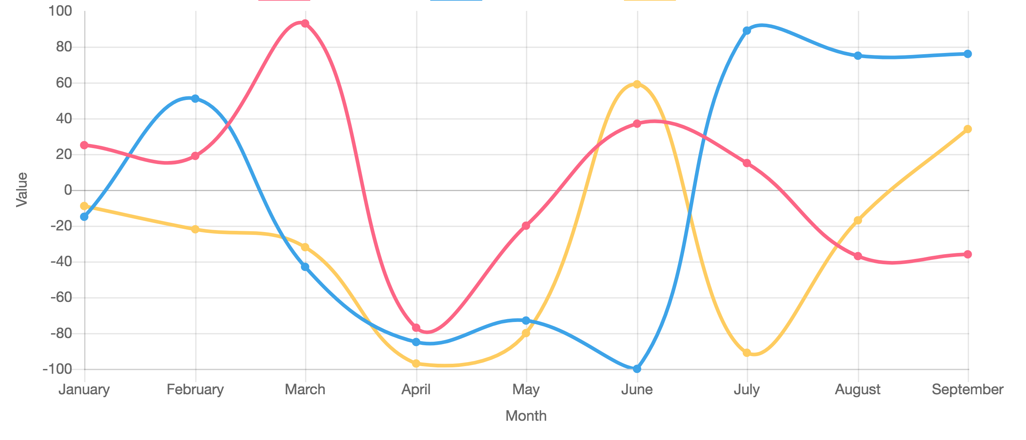
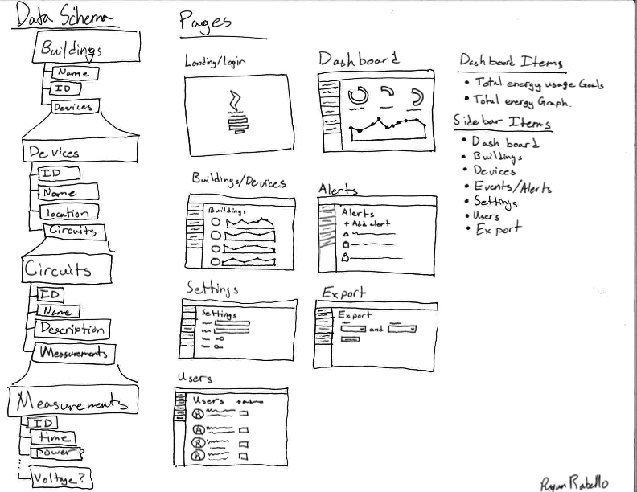
Advanced Features
Graph data by:
Building
Sub Panel
Circuit
Tag (Category)
Date comparisons
Progress chart
Exporting Data
Configuring alert settings
Open to suggestions

Slide 9
Sources
(Power monitoring system in University) https://www.sciencedirect.com/science/article/pii/S037877881200669X
(Electrical Management System) http://sssa.bioroboticsinstitute.it/sites/default/files/user_docs/isda11.pdf

Slide 10
Questions or suggestions?
Ryan Rabello
Ryan.Rabello@wallawalla.edu
(Software)
Nathan Zimmerly
Nathan.Zimmerly@wallawalla.edu
(Hardware)
Notes:
Where would we want to install the device?
Who will maintain this.
Software
Hardware
Manual For hardware and Software
Cost Reports
Configuring alerts emails
Peak time power usage is useful
Current CT usage
Looks to see if unit is on.
Records usage in peak demand
each building has it
backnet long
Use to figure out when to shut systems down.
be able to interact with current hvac/systems
Mention current systems to students and other engineering

Slide 11
Questions we have.
What is the current power monitoring system like?
What features are you looking for in a new power monitoring system?
How important is ease of installation?
Does the power bill play a significant role in the university’s budget?

Slide 12
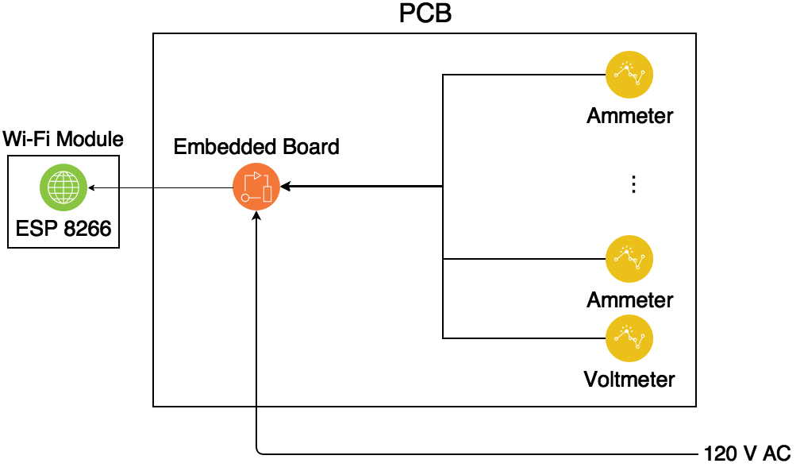
Block Diagram

Slide 13
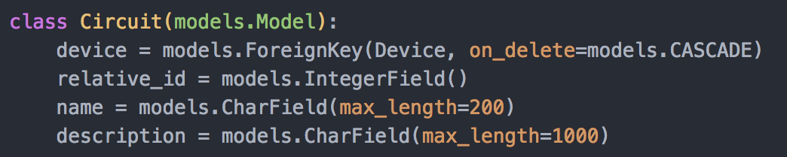
Database Models
Model form
Django models are really easy.
Django migrations are nice.
Archiving scheme.
Without loosing accuracy

Slide 14
